Slide 1
Self-pick-up cabinet

Slide 2
What is the goal of this project?
Help the users to get the takeout.It is convenient for every students and teachers to use this facility.

Slide 3
Use case-5:Data Processing
Let the database system to store the database of the users.
Flow of Events for Main Success Scenario:
----→a. The receivers finished the information,
←----b. The system receives this order, and request users to store the database
----→c. The users choose “yes”
←----d. The system stores the database and feedback to the receivers.

Slide 4
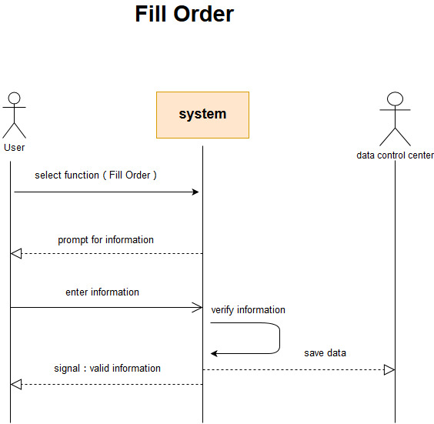
Use case -6:Users fill in order information
Ensuring accuracy and consistency of information.
Flow of Events for Main Success Scenario:
---→ a. Senders determine the type of food and take-out,
←---b. the system displays order information to users,
---→c. users fill in order information.
←---d. The system feedback to the users.

Slide 5
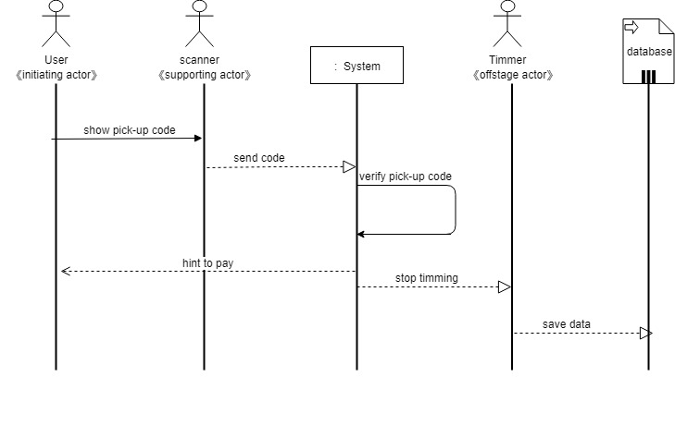
Use case-13:User scans the code
Receivers get the food and takeout.
Flow of Events for Main Success Scenario:
---→a. The system got the information code and sent the access code to the recipients.
←---b. The recipients got the access code.

Slide 6
